Slide 1
SEVEN STEPS to JDBC

Slide 2
the 7 step process to create a Java JDBC connection ARE:
Import the packages
Register the drivers
Establish a connection
Create a statement
Execute the query
Retrieve results
Close the connections

Slide 3
STEP 1: Import the packages
This includes uploading all the packages containing the JDBC classes, interfaces, and subclasses used during the database programming.
JDBC API 4.0 mainly provides 2 important packages:
1.java.sql
2.javax.sql
import java.sql.*;

Slide 4
STEP 2: Register the drivers
Before connecting to the database, we’ll need to load or register the drivers once per database. This is done to create a communication channel with the database. Loading a driver can be done in two ways:
Class.forName()
DriverManager.registerDriver()

Slide 5
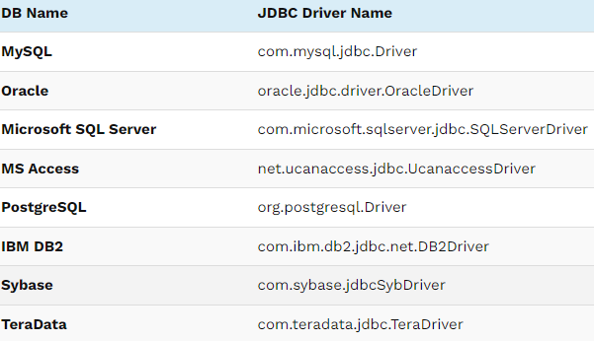
Class.forname()
Class.forName(“Com.mysql.jdbc.Driver”);

Slide 6

DriverManager.registerDriver()
DriverManager is an inbuilt class that is available in the java.sql package. It acts as a mediator between Java application and database which you want to connect.

Slide 7
STEP 3: Establish a connection
DriverManager class has the getConnection method, we will use this method to get the connection with Database. To call getConnection() method, we need to pass 3 parameters. The 3 parameters are string data type URL, a username, and a password to access the database.
The getConnection() method is an overloaded method. The 2 methods are:
getConnection(URL,username,password);
getConnection(URL);
Connection conn=DriverManager.getConnection("jdbc:mysql://localhost:3306/app-name","root","root");

Slide 8
STEP 4: Create a statement
There are 3 statement interfaces are available in the java.sql package.
1.Statement
This interface is used to implement simple SQL statements with no parameter. It returns the ResultSet object.
Statement stmt = conn.createStatement();
2. PreparedStatement
This PreparedStatement interface extends the Statement interface. So, it has more features than the Statement interface. It is used to implement parameterized and precompiled SQL statements. The performance of the application increases because it compiles the query only once.

Slide 9
String select_query = “Select * from states where state_id = 1”;
PreparedStatement prpstmt = conn.prepareStatement(select_query);
3. CallableStatement
CallableStatement interface extends the PreparedStatement interface. So, it has more features than the PreparedStatement interface. It is used to implement a parameterized SQL statement that invokes procedure or function in the database. A stored procedure works like a method or function in a class. It supports the IN and OUT parameters.
CallableStatementcallStmt = con.prepareCall("{call procedures(?,?)}");

Slide 10
STEP 5: execute the query
There are 4 important methods to execute the query in Statement interface.
ResultSet executeQuery(String sql)
executeUpdate(String sql)
execute(String sql)
executeBatch()

Slide 11
STEP 6: Retrieve results
When queries are executed using the executeQuery() method, it produces results stored in the ResultSet object. The ResultSet object is then used to access the retrieved data from the database.
ResultSet rs 1= statemnt1.executeQuery(QUERY));

Slide 12
STEP 7: close the connections
Finally, we are done with manipulating data in DB. Now we can close the JDBC connection. We need to make sure that we have closed the resource after we have used it. If we don’t close them properly we may end up out of connections.
When we close the connection object, Statement and ResultSet objects will be closed automatically.
conn.close();

Slide 13
https://www.softwaretestinghelp.com/jdbc-connection-steps/#1_Import_Packages
REFERENCES
https://www.turing.com/kb/what-is-jdbc
https://www.softwaretestinghelp.com/jdbc-connection-steps/#1_Import_Packages

Slide 14
Slide Tite
We are going to have a great year learning together!

